Slide 1
Web Design VS Web Development

Slide 2

Made By
Ahmed Mohamed Abubakr
Student at faculty of engineering Suhag university (electronics and communications department)
Full stack web developer
Leader of SMART (student activity)

Slide 3


Slide 4
THE WEB ?!!
What is websites and why we make it ?
What is the sections inside it ?
How I work ?
What do I need to start ?

Slide 5
Developers VS Designers
What do we call designers and developers ?
What tools they use ?
Who starts the project ?

Slide 6
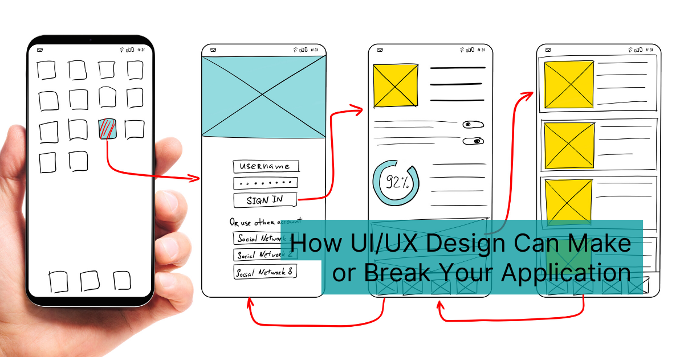

Slide 7
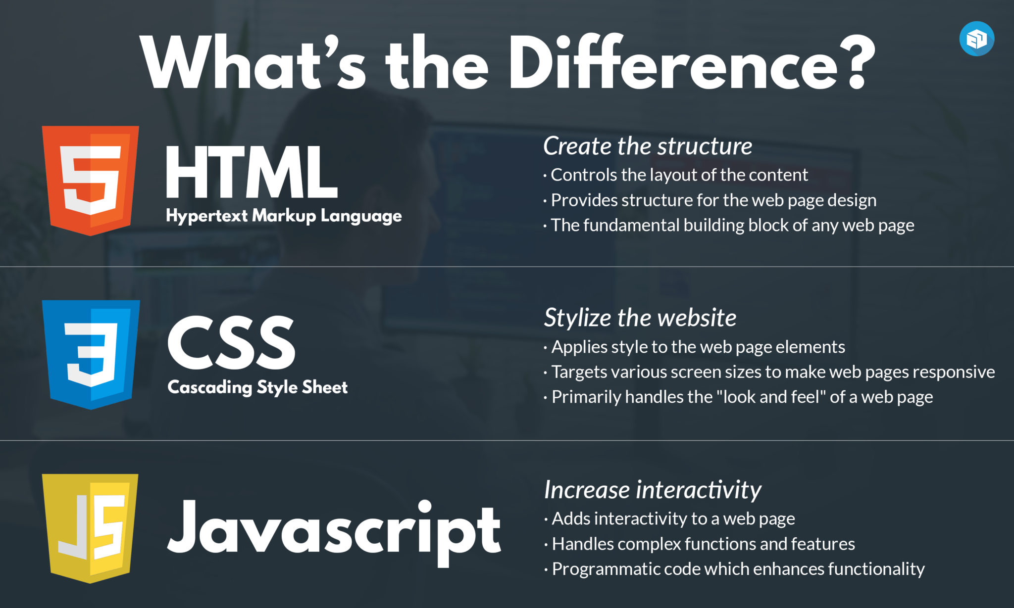

Slide 8
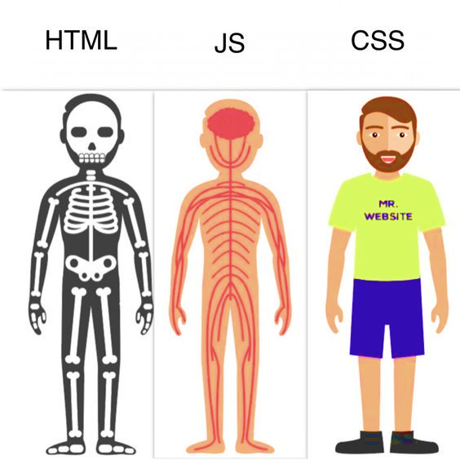

Slide 9
Programming VS Markup VS script languages

Slide 10
Mark-up language
Descriptions of how text and other forms of components should appear in a certain context (i.e. HTML, hypertext mark-up language - is the instructions for the context of a web page).
Mark up languages tend to provide structure to data and/or determine how it is displayed.
• HTML- hypertext mark-up language
• Dynamic HTML
• XML-extensible mark-up language
• XHTML- extensible hypertext mark-up language
• CSS

Slide 11
Programming language
A programming language is a language used by humans to give instructions to a machine.
The other main type is compiled programming languages. C, C++, Objective-C, Swift. These take text files, run them through a compiler, and the compiler creates binary instruction files (binaries). These are the lower level languages, they "talk to" the memory and processor and such. I know C and Swift were each wrote in themselves. In other words, C is wrote in the language C. Swift is wrote in Swift.
Programming languages (almost always) need to be compiled before running and instruct the computer to perform tasks/calculations, including how to perform them (although if you're using a high-level language the low level instructions are hidden in the syntax).
• JAVA, C++, COBOL, C++ and VB, C#, etc.

Slide 12
Scripting language
Usually use an interpreter or some running application to take programming commands and turn them into instructions to be executed. Scripting languages are programming languages, but they fit into a category called interpreted languages (i.e. Python, Ruby and PHP). We can write full featured applications with scripting languages.
A scripting language is a subset of programming language that is used to produce scripts, which are sets of instructions that automate tasks that would otherwise be performed manually by a human. Of course, these "tasks" are essentially a human giving instructions to a machine.

Slide 13
Difference between Programming Language and Mark-up Language
Sometimes the terms programming language and scripting language are used colloquially to describe compiled programming languages and interpreted programming languages, respectively. Compiled programming languages are languages whose instructions are translated (compiled) directly into machine code, whereas interpreted languages are those that require a program known as an interpreter, which interprets instructions in terms of previously compiled machine code.
Mark up languages annotate the content of a document with information on the document's structure or presentation. More recently, the task of annotating documents with information about their presentation has been delegated to style sheet languages, such as Cascading Style Sheets (CSS). Both are related to historical, physical mark up and style sheets as seen in publishing and other fields.

Slide 14
Lets have example
<!DOCTYPE html>
<html>
<head>
<title>Hi-from-title</title>
</head>
<body>
<h1>This is a page</h1>
<p>a very simple page</p>
</body>
</html>

Slide 15
Style the page
<style>
h1 {
color: red;
}
</style>

Slide 16
Script it
<script>
document.write("hi");
</script>

Slide 17
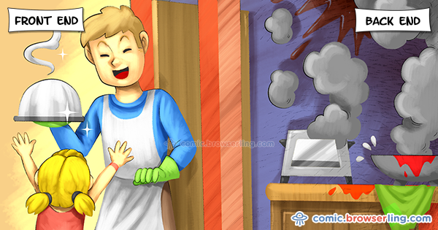

Slide 18
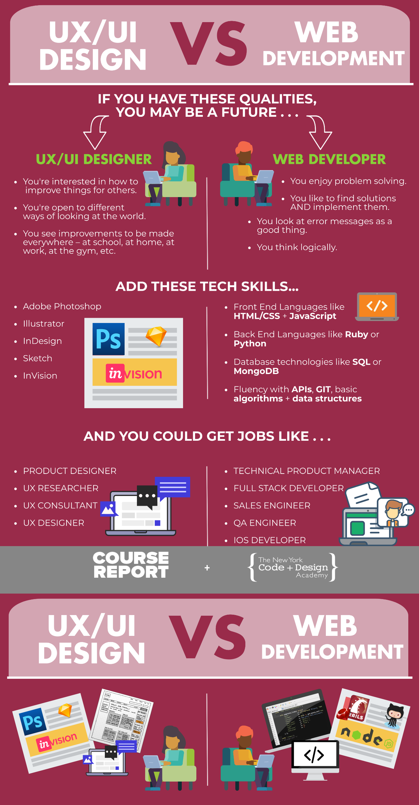

Slide 19
The End
in the end I hope you understood all I said contact on :
https://www.facebook.com/abobakr143
https://wa.me/201113284597

